Slide 1
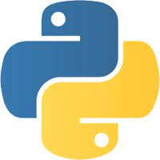
WHAT IS PYTHON?
Python is a very popular general-purpose interpreted, interactive, object-oriented, and high-level programming language. It was created by Guido van Rossum during 1985- 1990. Like Perl, Python source code is also available under the GNU General Public License (GPL)
Python is Interpreted − Python is processed at runtime by the interpreter. You do not need to compile your program before executing it. This is similar to PERL and PHP.
Python is Interactive − You can actually sit at a Python prompt and interact with the interpreter directly to write your programs.
Python is Object-Oriented − Python supports Object-Oriented style or technique of programming that encapsulates code within objects.
Python can be used on a server to create web applications.
Python can be used alongside software to create workflows.
Python can connect to database systems. It can also read and modify files.
Python can be used to handle big data and perform complex mathematics.
Python can be used for rapid prototyping, or for production-ready software development.

Slide 2
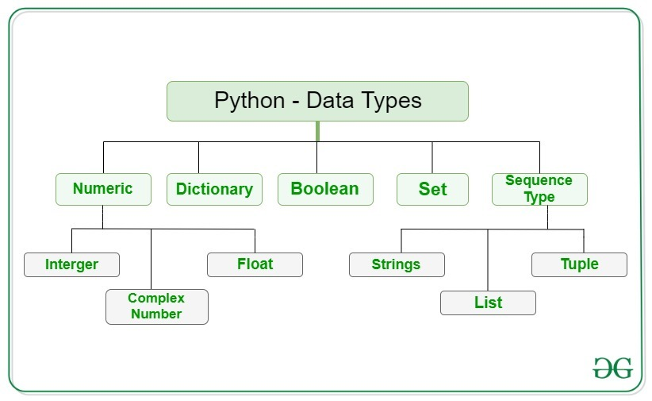
print("Hello, World!")
Hello world!
DATA TYPES
Numeric – this value represent by the data which is numeric value
int =1,2,3,
float=1.22,
complex=1+2j
Dictionary – it is a key :value pair
{1:2 , 3:4}
Set – It is an unordered collection of data type that is iterable, mutable.
{1,2,3,4,5}
Boolean – data type one of the two built –in- function
true
or
false
Sequence type - sequence is the ordered collection of
similar or different data types
String =“a”,”b”,”c”,”d”,”e”
List =[a,b,c,d,e]
Tuple =(a,b,c,d,e,)

Slide 3
TYPES OF OPERATOR
Arithmetic Operators
Comparison (Relational) Operators
Assignment Operators
Logical Operators
Bitwise Operators
Membership Operators(in ,not in )
Identity Operators
Python - Decision Making:
Decision making is anticipation of conditions occurring while execution of the program
and specifying actions taken according to the conditions. TRUE or FALSE as outcome.

Slide 4
STATEMENT:
if statement If else statement If – else if - else statement
LOOPS:
While loop
Repeats a statement or group of statements while a given condition is TRUE. It tests the condition before executing the loop body.
For loop
Executes a sequence of statements multiple times and abbreviates the code that manages the loop variable.
Nested loop
You can use one or more loop inside many another while, for or do while loop
LOOP CONTROL STATEMENT :
Break statement
Terminates the loop statement and transfers execution to the statement immediately following the loop.
Continue statement
Causes the loop to skip the remainder of its body and immediately retest its condition prior to reiterating.
Pass statement
The pass statement in Python is used when a statement is required syntactically but you do not want any command or code to execute.
Function:
A function is a block of code which only runs when it is called. you can pass data, known as parameters, into a function. A function can return data as a result.

Slide 5
Lambda:
A lambda function is a small function.
A lambda function can take any number of arguments, but can only have one expression.
filter, map ,reduce are used in lambda function
Class:
__Init__ :All classes have a function called __init__(), which is always executed when the class is being initiated.
(self): The self parameter is a reference to the current instance of the class, and is used to access variables that belongs to the class. It does not have to be named self , you can call it whatever you like, but it has to be the first parameter of any function in the class:
Pass: put in the pass statement to avoid getting an error.
Iter:
An iterator is an object that contains a countable number of values.
Technically, in Python, an iterator is an object which implements the iterator protocol, which consist of the methods __iter__() and __next__().
To prevent the iteration to go on forever, we can use the StopIteration statement.
SCOPE:
Local scope: A variable created inside a function belongs to the local scope of that function, and can only be used inside that function.
Global Scope: A variable created in the main body of the Python code is a global variable and belongs to the global scope. Global variables are available from within any scope, global and local.

Slide 6
Python Dates
A date in Python is not a data type of its own, but we can import a module named datetime to work with dates as date objects. The datetime() class requires three parameters to create a date: year, month, day.
The method is called strftime(), and takes one parameter, format, to specify the format of the returned string
ABS : The abs() function returns the absolute (positive) value of the specified number:
POW : pow(x, y) function returns the value of x to the power of y.(2,3)(2*2*2=8)
incase three values were given (x,y,z)=((x**y)%z)
What is PIP: PIP is a package manager for Python packages, or modules if you like.
What is a Package: A package contains all the files you need for a module.
Modules are Python code libraries you can include in your project.
Exception Handling
When an error occurs, or exception as we call it, Python will normally stop and generate an error message.
The try block lets you test a block of code for errors.
The except block lets you handle the error.
You can use the else keyword to define a block of code to be executed if no errors were raised:
The finally block, if specified, will be executed regardless if the try block raises an error or not.
Raise an exception
As a Python developer you can choose to throw an exception if a condition occurs.
To throw (or raise) an exception, use the raise keyword.

Slide 7
String format()
The format() method allows you to format selected parts of a string.
File Handling
The key function for working with files in Python is the open() function.
The open() function takes two parameters; filename, and mode.
Modes:
"r" - Read Opens a file for reading, error if the file does not exist
"a" - Append - Opens a file for appending, creates the file if it does not exist
"w" - Write - Opens a file for writing, creates the file if it does not exist
"x" - Create - Creates the specified file, returns an error if the file exists
"t" - Text - Default value. Text mode
"b" - Binary - Binary mode (e.g. images)
Delete a File
To delete a file, you must import the OS module, and run its os.remove() function
import os
os.remove("demofile.txt")
To delete an entire folder, use the os.rmdir() method
os.rmdir(“foldername”)

Slide 8
OBJECT ORIENTED PROGRAMING (OOPS)
1.CLASS AND OBJECT
classes provide a means of bundling data and functionality together. Creating a new class creates a new type of object, allowing new instances of that type to be made. Each class instance can have attributes attached to it for maintaining its state. Class instances can also have methods (defined by their class) for modifying their state.
2.CONSTRUCTOR
In Python the __init__() method is called the constructor and is always called when an object is created.
default constructor: The default constructor is a simple constructor which doesn’t accept any arguments
parameterized constructor: constructor with parameters is known as parameterized constructor. The parameterized constructor takes its first argument as a reference to the instance being constructed known as self and the rest of the arguments are provided by the programmer.
3.DESTRUCTOR
Destructors are called when an object gets destroyed. In Python, The __del__() method is a known as a destructor method in Python. It is called when all references to the object have been deleted.
4.INHERITANCE
Inheritance is the capability of one class to derive or inherit the properties from another class.
It represents real-world relationships well.
It provides the reusability of a code. We don’t have to write the same code again and again. Also, it allows us to add more features to a class without modifying it. which means that if class B inherits from another class A, then all the subclasses of B would automatically inherit from class A.

Slide 9
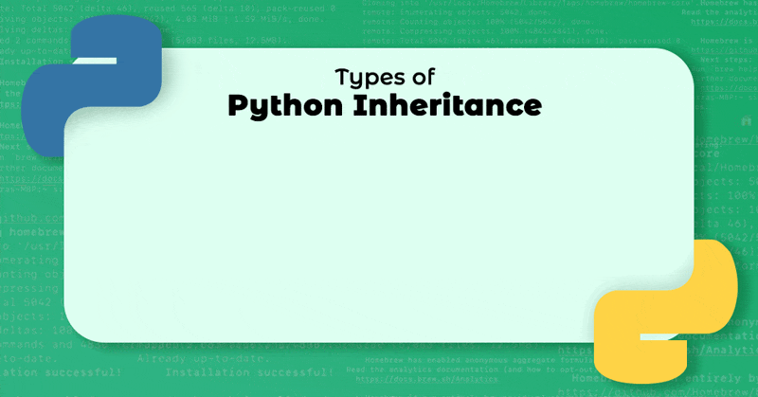
TYPES OF INHERITANCE
1.Single Inheritance:
Single inheritance enables a derived class to inherit properties from a single parent class, thus enabling code reusability and the addition of new features to existing code.
2.Multiple Inheritance:
When a class can be derived from more than one base class this type of inheritance is called multiple inheritances. In multiple inheritances, all the features of the base classes are inherited into the derived class.
3.Multilevel Inheritance :
In multilevel inheritance, features of the base class and the derived class are further inherited into the new derived class. This is similar to a relationship representing a child and a grandfather.
4.Hierarchical Inheritance:
When more than one derived class are created from a single base this type of inheritance is called hierarchical inheritance. In this program, we have a parent (base) class and two child (derived) classes.
5.Hybrid Inheritance:
Inheritance consisting of multiple types of inheritance is called hybrid inheritance.

Slide 10
5.ENCAPSULATION
Encapsulation is one of the fundamental concepts in object-oriented programming (OOP). It describes the idea of wrapping data and the methods that work on data within one unit. This puts restrictions on accessing variables and methods directly and can prevent the accidental modification of data. To prevent accidental change, an object’s variable can only be changed by an object’s method. Those types of variables are known as private variables.
protected members - Protected members (in C++ and JAVA) are those members of the class that cannot be accessed outside the class but can be accessed from within the class and its subclasses. To accomplish this in Python, just follow the convention by prefixing the name of the member by a single underscore “_”.
private members - Private members are similar to protected members, the difference is that the class members declared private should neither be accessed outside the class nor by any base class. In Python, there is no existence of Private instance variables that cannot be accessed except inside a class.
6. POLYMORPHISM:
The word polymorphism means having many forms. In programming, polymorphism means the same function name (but different signatures) being used for different types.
7.CLASS AND STATIC
All objects share class or static variables. An instance or non-static variables are different for different objects (every object has a copy).

Slide 11
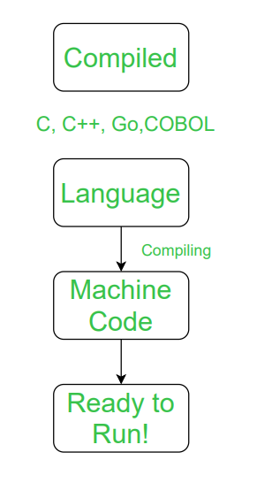
PYTHON QUESTIONS AND ANSWERS
1 .What is python? What are the benefits using python?
python is a high-level, interpreted, and general-purpose dynamic programming language that focuses on code readability. It generally has small programs when compared to Java and C. It was founded in 1991 by developer Guido Van Rossum. Python ranks among the most popular and fastest-growing languages in the world. Python is a powerful, flexible, and easy-to-use language. In addition, the python community is very active. It is used in many organizations as it supports multiple programming paradigms. It also performs automatic memory management.
2.What is the interpreted language?
Compiled Language:
A compiled language is a programming language which are generally compiled and
not interpreted. It is one where the program, once compiled, is expressed in the instructions
of the target machine; this machine code is undecipherable by humans.
Types of compiled language – C, C++, C#, CLEO, COBOL, etc.

Slide 12
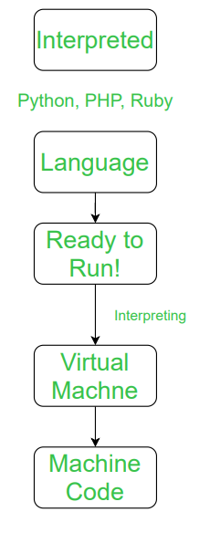
Interpreted Language?
An interpreted language is a programming language which are generally interpreted, without compiling a program into machine instructions. It is one where the instructions are not directly executed by the target machine, but instead read and executed by some other program. Interpreted language ranges – JavaScript, Perl, Python, BASIC, etc.
3.What is scope in python?
Local Scope
A variable created inside a function belongs to the local scope of that function, and can only be used inside that function.
Global Scope
A variable created in the main body of the Python code is a global variable and belongs to the global scope.
Global variables are available from within any scope, global and local.

Slide 13
4.What are the list and tuple? what are the key difference in between these two
SR.NO. | LIST | TUPLE
1 | Lists are mutable | Tuples are immutable
2 | The implication of iterations is Time-consuming | The implication of iterations is comparatively Faster
3 | The list is better for performing operations, such as insertion and deletion. | Tuple data type is appropriate for accessing the elements
4 | Lists consume more memory | Tuple consumes less memory as compared to the list
5 | Lists have several built-in methods | Tuple does not have many built-in methods.
6 | The unexpected changes and errors are more likely to occur | In tuple, it is hard to take place.

Slide 14
5.What are the common build in function?
Text Type: | str
Numeric Types: | int, float, complex
Sequence Types: | list, tuple, range
Mapping Type: | dict
Set Types: | set, frozenset
Boolean Type: | bool
Binary Types: | bytes, bytearray, memoryview
6.What are the use of self in python?
self represents the instance of the class. By using the “self” we can access the attributes and methods of the class in python. It binds the attributes with the given arguments.
The reason you need to use self. is because Python does not use the @ syntax to refer to instance attributes. Python decided to do methods in a way that makes the instance to which the method belongs be passed automatically, but not received automatically: the first parameter of methods is the instance the method is called on.

Slide 15
7.What is __init__ in Python?
The Default __init__ Constructor in C++ and Java. Constructors are used to initializing the object’s state. The task of constructors is to initialize(assign values) to the data members of the class when an object of the class is created. Like methods, a constructor also contains a collection of statements(i.e. instructions) that are executed at the time of Object creation. It is run as soon as an object of a class is instantiated. The method is useful to do any initialization you want to do with your object.
8.What is the Lambda Function in python?
Python lambda function are anonymous function means that the function is without a name. As we already know that the def keyword is used to define a normal function in Python. Similarly, the lambda keyword is used to define an anonymous function in Python.
Syntax: lambda arguments: expression
This function can have any number of arguments but only one expression, which is evaluated and returned.
One is free to use lambda functions wherever function objects are required.
You need to keep in your knowledge that lambda functions are syntactically restricted to a single expression.
It has various uses in particular fields of programming, besides other types of expressions in functions.

Slide 16
9.When to use a tuple vs list vs dictionary in python?
List and Tuple objects are sequences. A dictionary is a hash table of key-value pairs. List and tuple is an ordered collection of items. Dictionary is unordered collection. List and dictionary objects are mutable i.e. it is possible to add new item or delete and item from it. Tuple is an immutable object. Addition or deletion operations are not possible on tuple object. Each of them is a collection of comma-separated items. List items are enclosed in square brackets [], tuple items in round brackets or parentheses (), and dictionary items in curly brackets {}
10.How is memory managed in python?
Understanding Memory allocation is important to any software developer as writing efficient code means writing a memory-efficient code. Memory allocation can be defined as allocating a block of space in the computer memory to a program. In Python memory allocation and deallocation method is automatic as the Python developers created a garbage collector for Python so that the user does not have to do manual garbage collection.
Garbage collection is a process in which the interpreter frees up the memory when not in use to make it available for other objects.
Assume a case where no reference is pointing to an object in memory i.e. it is not in use so, the virtual machine has a garbage collector that automatically deletes that object from the heap memory

Slide 17
11.What are the key features of python?
Python is a dynamic, high-level, free open source, and interpreted programming language. It supports object-oriented programming as well as procedural-oriented programming.
Free and Open Source
Easy to code-
Easy to Read-
Object-Oriented Language -
GUI Programming Support-
High-Level Language-
Extensible feature –
Python is a Portable language-
Python is an Integrated language-
Large Standard Library -
Dynamically Typed Language -
Frontend and backend development
Allocating Memory Dynamically -.

Slide 18
12.What are Python Modules?
In Python, Modules are simply files with the “.py” extension containing Python code that can be imported inside another Python Program. In simple terms, we can consider a module to be the same as a code library or a file that contains a set of functions that you want to include in your application.
The module contains the following components:
13.what are the function in python?
A function is a block of organized, reusable code that is used to perform a single, related action. Functions provide better modularity for your application and a high degree of code reusing. As you already know, Python gives you many built-in functions like print(), etc. but you can also create your own functions. These functions are called user-defined functions.
14.What are decorators in python?
decorators are a very powerful and useful tool in Python since it allows programmers to modify the behaviour of a function or class. Decorators allow us to wrap another function in order to extend the behaviour of the wrapped function, without permanently modifying it. But before diving deep into decorators let us understand some concepts that will come in handy in learning the decorators.

Slide 19
15.What are the python packages?
A python package is a collection of modules. Modules that are related to each other are mainly put in the same package. When a module from an external package is required in a program, that package can be imported and its modules can be put to use. Any Python file, whose name is the module's name property without the .
16. Indentation required in python?
Indentation refers to the spaces at the beginning of a code line. Where in other programming languages the indentation in code is for readability only, the indentation in Python is very important. python uses indentation to indicate a block of code.
17.How does break continue and pass work?
BREAK | CONTINUE | PASS
The break statement is used to terminate the loop or statement in which it is present. After that, the control will pass to the statements that are present after the break statement, if available. | Continue is also a loop control statement just like the break statement. continue statement is opposite to that of break statement, instead of terminating the loop, it forces to execute the next iteration of the loop. | As the name suggests pass statement simply does nothing. The pass statement in Python is used when a statement is required syntactically but you do not want any command or code to execute. It is like null operation, as nothing will happen is it is executed.

Slide 20
18.What is the MAP function in python?
Map in Python is a function that works as an iterator to return a result after applying a function to every item of an iterable (tuple, lists, etc.). It is used when you want to apply a single transformation function to all the iterable elements. The iterable and function are passed as arguments to the map in.
19.What is the pickling and unpickling in python?
The pickle module is used for implementing binary protocols for serializing and de-serializing a Python object structure.
Pickling: It is a process where a Python object hierarchy is converted into a byte stream.
Unpickling: It is the inverse of Pickling process where a byte stream is converted into an object hierarchy.
20.What are the list and dict comprehensions?
List Comprehensions : A list comprehension processes data to return a list of values afterwards.
n = [1, 6, 4, 2, 9, 15, 5] squared_n = [x * x for x in n]
Dictionary Comprehensions : A dictionary comprehension is similar to a list comprehension except it returns a dictionary of keys and values instead of a plain list.
numbers_with_squares = {x: x*x for x in range(1, 11)}

Slide 21
21.Define encapsulation in python?
Encapsulation in Python describes the concept of bundling data and methods within a single unit. So, for example, when you create a class, it means you are implementing encapsulation. A class is an example of encapsulation as it binds all the data members (instance variables) and methods into a single unit.
22.What is polymorphism in python?
The literal meaning of polymorphism is the condition of occurrence in different forms. Polymorphism is a very important concept in programming. It refers to the use of a single type entity (method, operator or object) to represent different types in different scenarios.
23. What is Docstring in python ?
A Python docstring is a string used to document a Python module, class, function or method, so programmers can understand what it does without having to read the details of the implementation. Also, it is a common practice to generate online (html) documentation automatically from docstrings.
24.What is slicing in python?
The slice() function returns a slice object. A slice object is used to specify how to slice a sequence. You can specify where to start the slicing, and where to end. You can also specify the step, which allows you to e.g. slice only every other item.

Slide 22
25.What is monkey patching in python ?
In Python, the term monkey patch refers to dynamic (or run-time) modifications of a class or module. In Python, we can actually change the behavior of code at run-time.
26.What is the difference between “/” and “//” operator in python?
Float Division("/"): Divides left hand operand by right hand operand. Eg: 5/2 = 2.5
Floor Division("//"): The division of operands where the result is the quotient in which the digits after the decimal point are removed. But if one of the operands is negative, the result is floored , i.e., rounded away from zero (towards negative infinity). Eg : 5//2 = 2
27.What is the regression ?
he term regression is used when you try to find the relationship between variables.
In Machine Learning, and in statistical modeling, that relationship is used to predict the outcome of future events.
28.Define modules in python ?
A Python module is a file containing Python definitions and statements. A module can define functions, classes, and variables. A module can also include runnable code. Grouping related code into a module makes the code easier to understand and use. It also makes the code logically organized.

Slide 23
THANK YOU!..

